Slide 1
Tableau Dashboard Actions
Kelly Jones – June 13, 2018

Slide 2
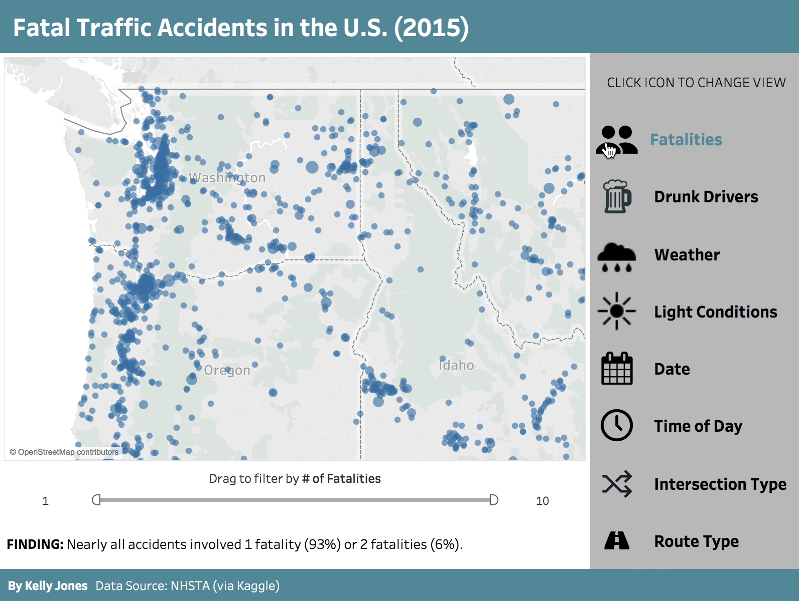
Remember This?

Slide 3

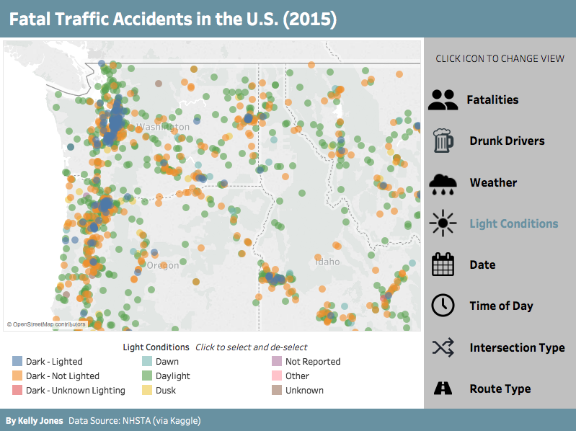
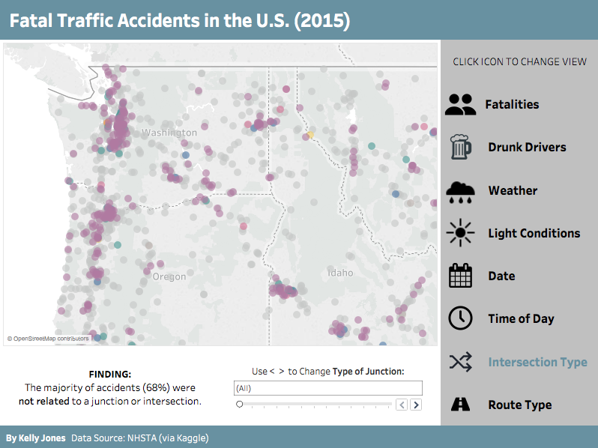
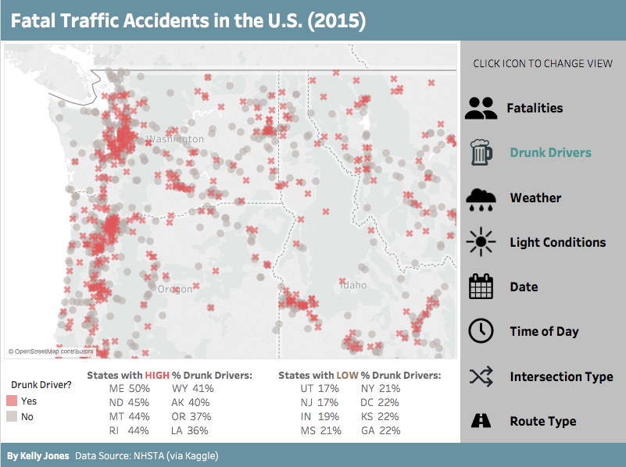
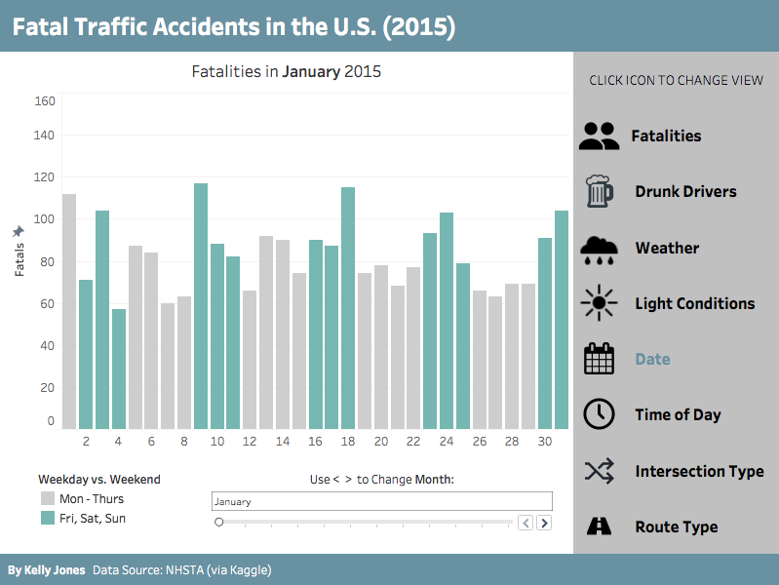
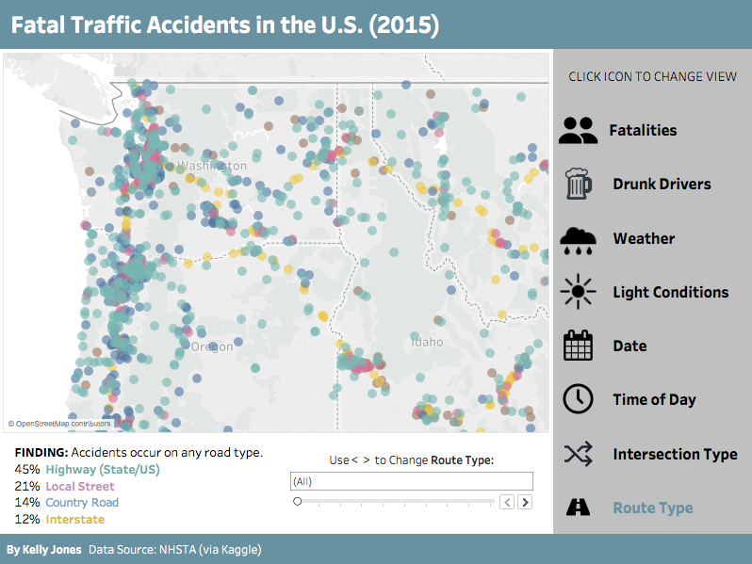
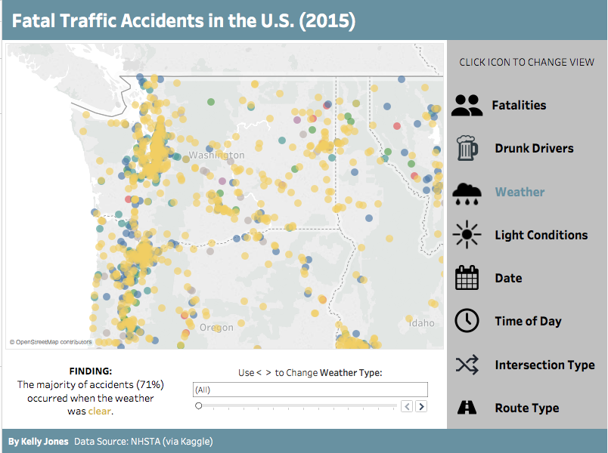
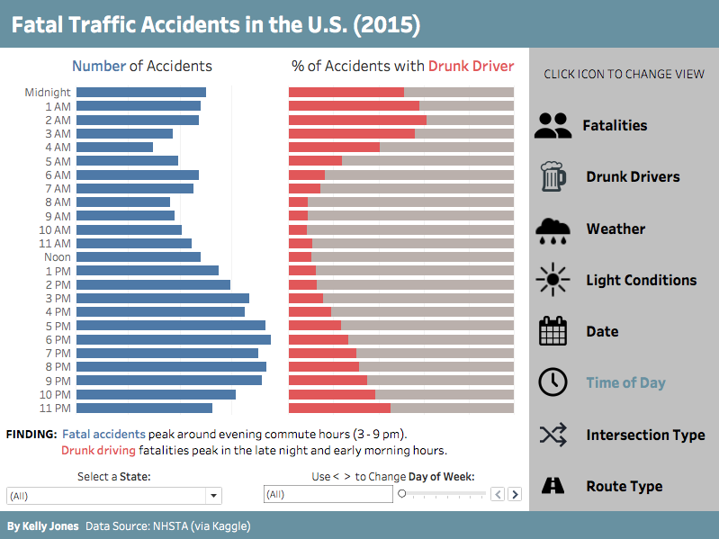
This is actually EIGHT (8!) nearly identical dashboards

Slide 4
Change Two Things
2. Color of one text box
1. Main worksheet

Slide 5
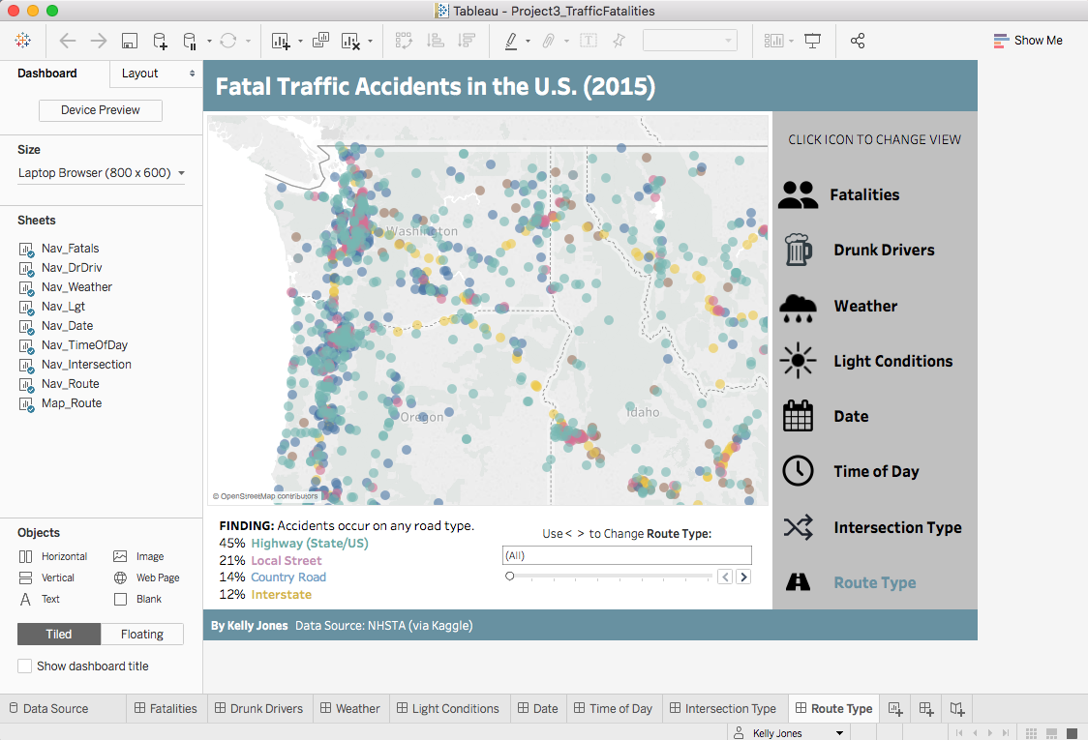
Final View: 8 dashboards 16 worksheets hidden
1 2 3 4 5 6 7 8
New worksheet
New dashboard
New story

Slide 6
Anatomy of a Dashboard
W
W
Worksheet
W
W
W
W
W
^ Filter
W

Slide 7
Anatomy of a Dashboard
Text
Text Box
Text Box
Text Box
Text Box
Text Box
Text Box
Text Box
Text Box
Text
Text Box
Text
Notes:
Note: text boxes have background colors – removed “padding” 4 px default to 0

Slide 8
Why Worksheets for Icons?
So we can use actions.

Slide 9
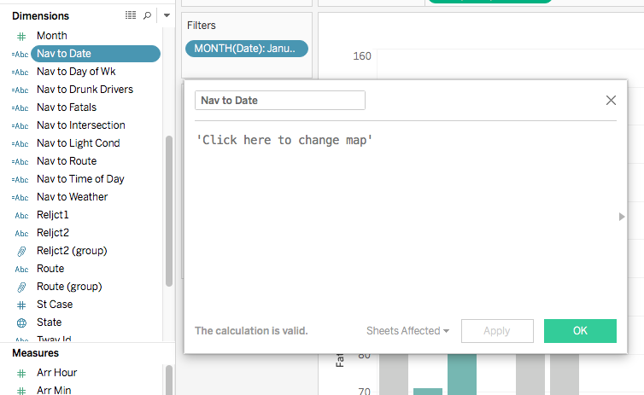
Step 1. Create 8 new variables for navigation
Nav to Date
Nav to Day of Wk
Nav to Drunk Drivers
Nav to Fatals
Nav to Intersection
Nav to Light Cond
Nav to Time of Day
Nav to Weather
Calculated field (string value)

Slide 10
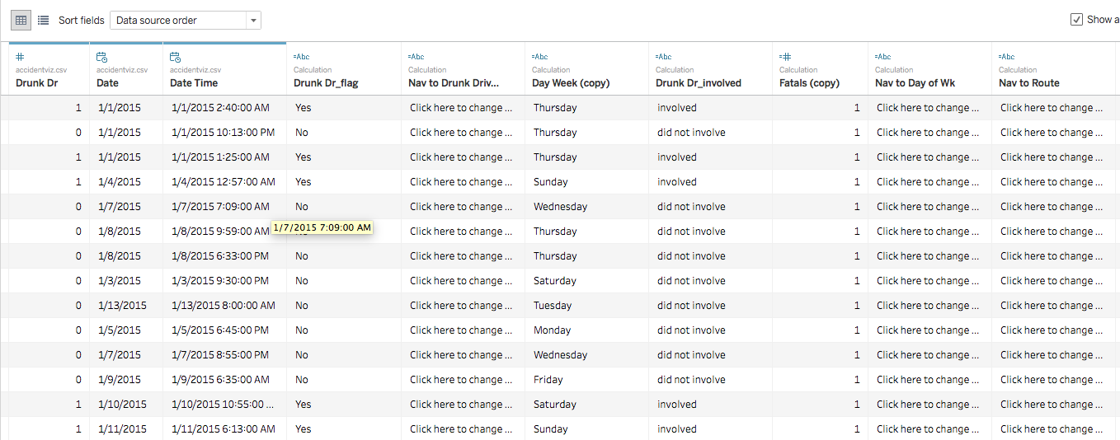

Slide 11
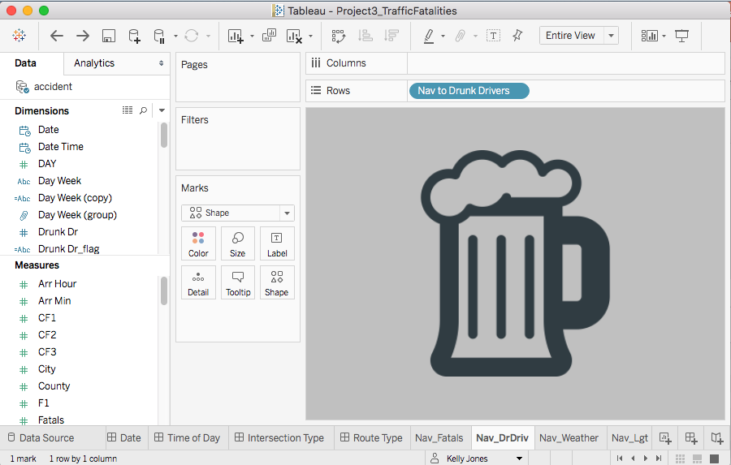
Step 2. Create 8 new worksheets with just an icon.

Slide 12
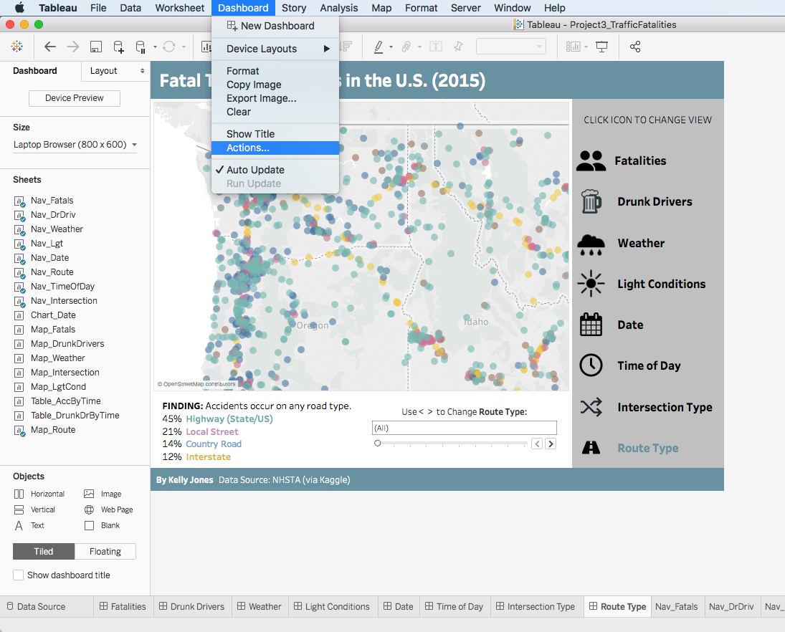
Step 3. Attach an action to each icon worksheet.
Go to a dashboard and use menus: Dashboard > Actions…

Slide 13
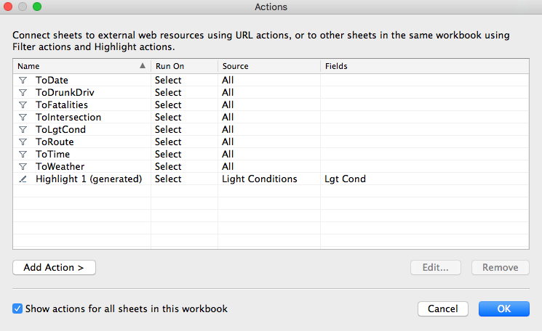
Click Add Action >
This is the “after” view with the 8 actions already added

Slide 14
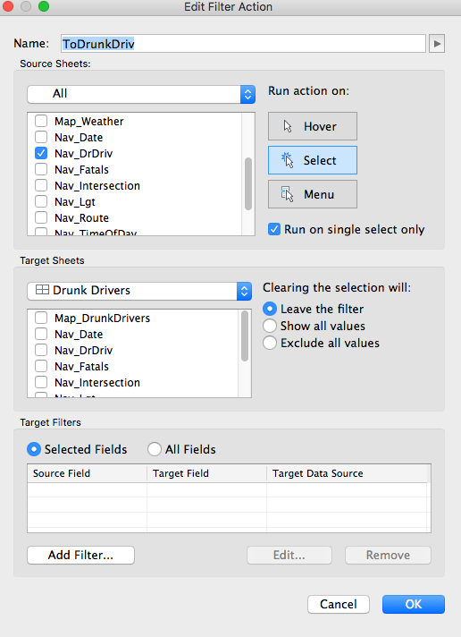
Create the action
1. Give your action a name
1
2. Select which sheet to apply the action to (we chose our beer mug sheet)
2
3
3
3. Run on “Select” Check “single select only
4
4. Select target sheet from dropdown – where should the action take you?
5
5. Target Filters should be “Selected Fields”

Slide 15
Voila!
Questions?

